Slide 1
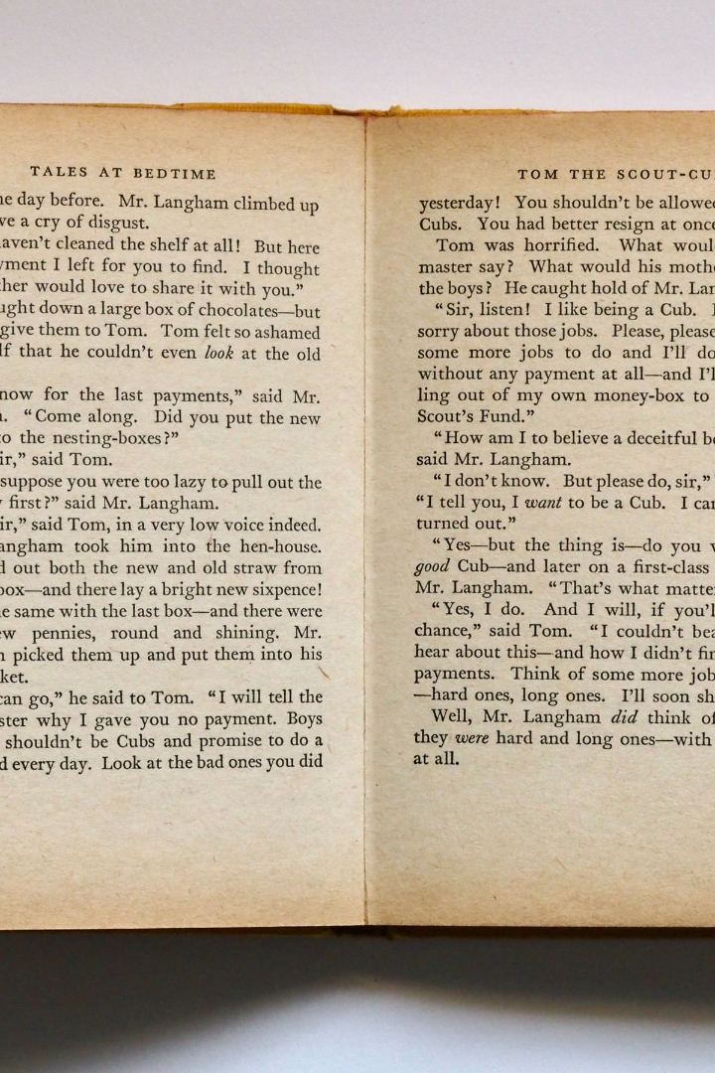
Text Processing For NLP Word Embedding
Text processing is the backbone of NLP, and Word Embedding is a powerful technique that makes NLP more accurate and efficient. In this presentation, we'll explore everything you need to know about Word Embedding and how it can transform NLP.

Slide 2
Understanding Word Embedding: Basics and Significance
What is Word Embedding?
Why is it significant?
Word Embedding is a technique that represents words in a continuous, multi-dimensional vector space where words that have similar meaning are closer to each other.
Word Embedding helps to better capture the meaning of natural language expressions and it helps to solve many of the challenges that are encountered when processing text data.
How does it work?
What are the benefits?
Word Embedding algorithms create vectors for each word in a corpus of text. Each dimension in the vector represents a different feature of the word, such as its part of speech, its semantic meaning, or its context in the text.
Word Embedding can improve the accuracy of NLP models, enhance the expressiveness of language, and enable machines to understand natural language more effectively.

Slide 3
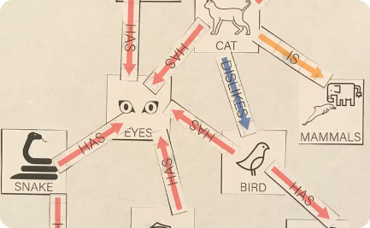
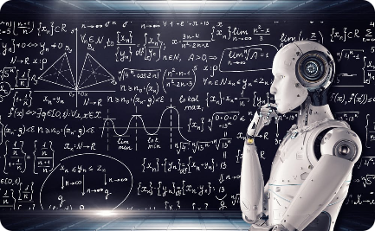
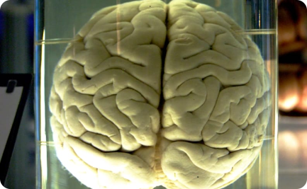
The Power of Semantic Representations
Connected Words
Intelligent Machines
Mimicking the Brain
Word Embedding enables semantic relationships between words to be represented as connections between nodes in a graph.
Word Embedding provides the foundation for machine learning algorithms to understand and interpret natural language expressions.
Word Embedding is inspired by the way that the human brain processes language and represents semantic knowledge.

Slide 4
Building Blocks of Word Embedding
Dimensionality Reduction
Text Preprocessing
Large word vectors are computationally expensive, so algorithms should be created that can reduce dimensionality without sacrificing accuracy.
The text data must be cleaned, normalized, and tokenized before it can be used for training.
1
2
3
4
Corpus Creation
Vocabulary Selection
A large collection of text data is needed to train a Word Embedding model.
The size and quality of the vocabulary selected for the training corpus is important for producing accurate Word Embedding models.

Slide 5
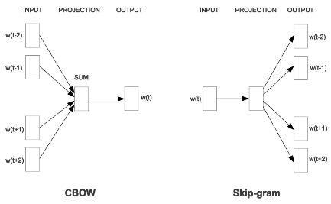
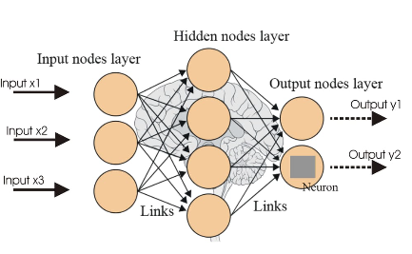

Word2Vec: Unveiling the Mechanics
The Origins
The Architecture
The Training Data
The Word2Vec algorithm was introduced in a 2013 paper by Tomas Mikolov, et al. It improved the performance of Word Embedding over previous methods.
The Word2Vec algorithm is based on a neural network architecture that uses a shallow, two-layer network to predict words based on their context.
The Word2Vec algorithm is trained on a text corpus to create word vectors that can represent the meaning and characteristics of words.

Slide 6

GloVe: Mapping Words in Vector Space
1
What is GloVe?
2
What are the differences?
GloVe is another popular Word Embedding algorithm, invented by Stanford researchers, that uses global statistical information to map words in vector space.
Word2Vec is a prediction-based algorithm, while GloVe uses co-occurrence statistics. GloVe also tends to handle rare words better than Word2Vec.
3
What are the benefits?
GloVe has been shown to perform well on a variety of NLP tasks and benchmarks, and it is often used in conjunction with other algorithms for improved performance.

Slide 7
Enhancing Language Models with Word Embedding
1
Language Modeling
Word Embedding can enhance language models by providing more expressive and accurate word representations.
Named Entity Recognition
2
By training Word Embedding models on named entity data, machines can better recognize people, places, and things in natural language text.
3
Text Classification
Word Embedding can be used to classify text data more accurately, by mapping words to meaningful feature vectors that capture important characteristics of the text.
Sentiment Analysis
4
Word Embedding can help machines to identify the sentiment or tone of natural language expressions, by representing the emotional content of words in vector space.

Slide 8

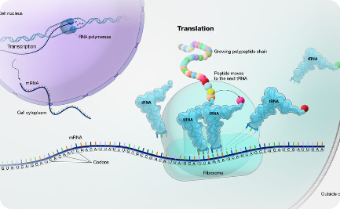
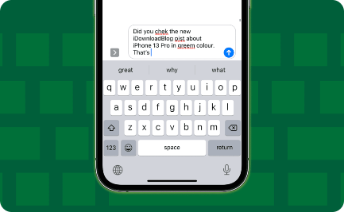
NLP Applications Boosted by Word Embedding
Virtual Assistants
Translation
Autocorrect
Word Embedding can help virtual assistants like Siri, Alexa, and Google Assistant to understand and respond to voice commands more accurately.
Word Embedding can enhance the accuracy and fluency of machine translation, by providing more contextually appropriate word choices.
Word Embedding can improve autocorrect algorithms by providing better suggestions for misspelled or mistyped words.

Slide 9
Exploring the Challenges of Word Embedding
Ambiguity and Polysemy
Contextualization
Words that have multiple meanings, or are used in multiple contexts, can be challenging to accurately represent in vector space.
Word Embedding is most effective when it can accurately represent words in context. However, context can be difficult to capture and interpret.
Cultural and Linguistic Differences
Data Selection and Quality
Word Embedding can struggle to accurately represent words and concepts that are specific to particular cultures or languages.
Word Embedding depends on large, high-quality data sets for accurate training. Data selection and cleaning are important for achieving good results.

Slide 10

Future Vistas in Word Embedding Research
1
Deeper Networks
2
Domain-Specific Models
New research is exploring the use of deeper and more complex neural networks for Word Embedding, to capture more nuanced and detailed representations of language.
Word Embedding can be optimized for specific domains or use cases, such as healthcare or finance, to improve accuracy and performance in those areas.
3
Interpretable Representations
Research is exploring new techniques for creating Word Embedding models that can be more easily interpreted and understood by humans.

Slide 11

Concluding Insights: Empowering NLP with Word Embedding
Word Embedding is a powerful and versatile technique for processing natural language text data. As NLP continues to grow in importance, Word Embedding will undoubtedly play a critical role in empowering machines to more effectively understand and interpret human language.

